Slide 1
Non-surgical interventions for the non-operated back pain patient
An update for primary care providers
"Lumbar Spine X-Ray L4 L5 S1" by planetc1 is licensed under CC BY-SA 2.0

Slide 2






Mehul J. Desai, MD, MPH
Medical Director, International Spine, Pain & Performance Center
Chief, Division of Pain Medicine, Virginia Hospital Center
Director, Interventional Spine and Musculoskeletal Medicine Fellowship (NASS)
Medical Director, the Performance Lab
President, Monument Research Institute
Clinical Assistant Professor, Department of Anesthesiology & Critical Care, George Washington University, School of Medicine

Slide 3
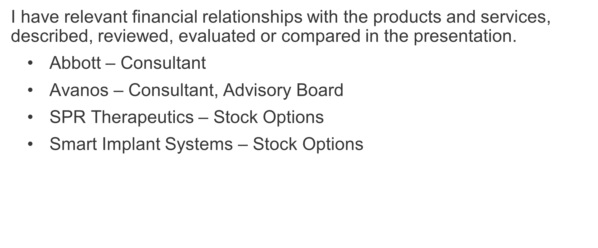
Disclosures

Slide 4
Agenda
Epidemiology and prognosis
Treatment challenges and limitations of common therapies
Newer minimally invasive interventions for virgin (non-operated) back pain
Patient treatment preferences
LBP treatment algorithm

Slide 5
Impact of low back pain (LBP)
#1 cause of global years lived with disability (YLD)¹
7.3% global point prevalence (activity-limiting)²
80%
of adults have LBP at some point³
$200 B
Est. annual cost of LBP in U.S.³
Vos Lancet 2016
Hartvigsen Lancet 2018
Rubin Neurol Clin 2007
Notes:
LBP is among the most common reasons for primary care visits
2/3 of costs are in lost productivity and wages

Slide 6
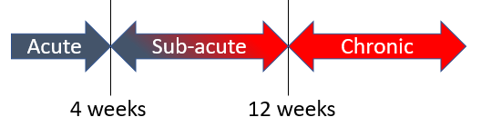
Prognosis in primary care
90% of acute LBP patients recover…
…but recurrence is common!
~10% develop chronic back pain¹
1. Meucci Rev Saude Publica 2015
Notes:
Acute back pain in primary care generally has a good prognosis
30-day pain and disability scores improve by an average of 58%
90% of LBP patients in primary care stop consulting with their doctor in 3 months
However, recurrence is common
~50% of LBP patients in primary care experience continuing or fluctuating pain of low to moderate intensity, with ~33% experiencing acute recurrence within 1 year
~10% of patients develop chronic pain

Slide 7
LBP patients seen in primary care
Epidemiology is often unclear
Axial pain is non-specific in ~70% of LBP patients
SI joint pain occurs in ~20% of LBP patients¹
Lumbar Spinal Stenosis (LSS) occurs in ~10% of LBP patients and is more common in the elderly²
Cohen Essentials of Pain Medicine 2018
Ishimoto Osteoarthritis Cartilage 2012
Notes:
LBP symptoms can derive from many potential anatomic sources: nerve roots, muscle, fascial structures, bones, joints, intervertebral discs, and abdominal organs
Identification of the specific source of pain can be challenging—most cases are classified as “non-specific” or mechanical (localized axial pain)
Leg pain often indicates LSS and is associated with SI joint problems

Slide 8
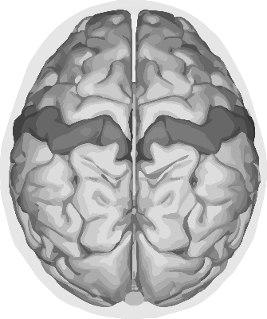
The urgency of treating pain
Unchecked nociceptive inputs can change the CNS, resulting in hypersensitivity to pain (central sensitization)¹
Imaging reveals brain structures are involved²
Potential for peripheral and central pain generators in LBP a present significant treatment challenges³
Central Sensitization → Chronicity
Woolf Pain 2011
Kuner Nat Rev Neurosci 2017
Allegri F1000Research 2016
Notes:
Though LBP treatment is challenging, persistent pain must be addressed to reduce risk of pain chronification
Since the 1980s, a growing body of evidence has demonstrated that pain itself produces changes within the central nervous system (central sensitization) that maintain and may perpetuate pain chronification, i.e., patients perceive more pain with increasingly less provocation (hyperalgesia)
More recently, neuroimaging technology has revealed that brain structures are also impacted by pain and exhibit changes that support the concept of central sensitization
The presence of both peripheral and central pain generators in chronic LBP is a significant treatment challenge

Slide 9

LBP and the opioid crisis
20% of LBP patients still fill an opioid Rx¹
Little evidence of efficacy in chronic LBP²
Non-pharma treatments needed for LBP
Non-surgical interventions can reduce opioid intake
Raad J Am Board Fam Med 2020
Deyo BMJ 2015
Gilmore American Society of Regional Anesthesia and Pain Medicine November 2019.
Al-Kaisy Pain Med 2018
Notes:
Despite national guidelines advising against front-line opioid use, 20% of U.S. outpatients with a new episode of isolated low back pain fill an opioid prescription
Broad variance between states: 13% (Hawaii)–34% (Arkansas)
There is little evidence supporting the efﬁcacy of opioids in treating chronic LBP, hastening return to work, or reducing the need for other treatments
New nonpharmacologic treatments for chronic LBP are clearly needed

Slide 10
Bottom Line
We need novel interventional treatments that are patient friendly and effective!

Slide 11

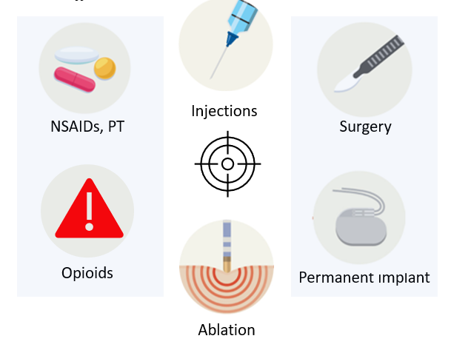
Conventional Treatments
Less Invasive
LESS effective
MORE Invasive
More Effective
Notes:
Conservative treatments and injections do not provide most patients adequate long-term relief
As we’ll see, the benefits of radiofrequency continue to be debated. A recent meta-analysis found that the positive effects of RF ablation appears to be small and short-term
Most patients are not eligible for open surgery to repair physical deformities (e.g., bone spurs, disc replacement); which in any case carries risk of failed back syndrome or need for reoperation
Permanent spinal cord stimulation implants have traditionally been a last resort after failed back surgery and are associated with high risk of complications.

Slide 12
Long-standing Therapies: Injections
Pain Management Injection Therapies for Low Back Pain, AHRQ 2015¹
Radiculopathy | Immediate, small, short-term, improvements common
Spinal Stenosis, facet joint pain | Evidence suggests that epidural/facet joint corticosteroid injections are not effective
SI joint pain | Insufficient evidence to evaluate effectiveness
Bottom Line: Low Risk, Minimal Benefit
1. Chou AHRQ 2015
Notes:
Epidural steroid injections (EPIs) may calm inflamed joints and tissues but do not affect healing
Though frequently helpful, large studies have found the average benefit of EPIs to be small to none*
Serious harms from injections were rare in RTCs and observational studies*
Selective nerve root blocks, used for diagnostics, may also provide short-term pain relief

Slide 13
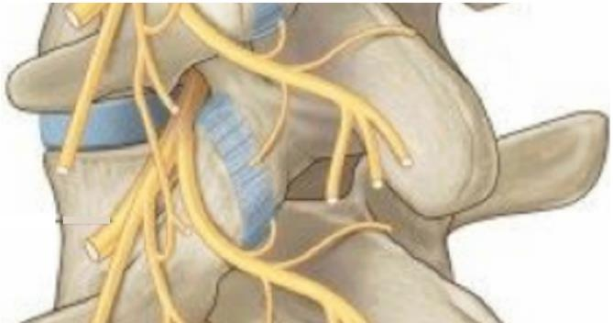
Long-standing therapies: RFA
RFA = Radiofrequency Ablation
Used for >20 years
Denervates select peripheral nerves with heated needle probe
Typically involves repeated procedures
Medial
Branch
Nerve
Medial Branch RFA/Denervation
Adapted from: https://anatomia-fisioterapia.es/en/lumbar/articles/systems/musculoskeletal/spine/lumbar/analysis-of-the-posterior-ramus-of-the-lumbar-spinal-nerve-the-structure-of-the-posterior-ramus-of-the-spinal-nerve
Notes:
RFA uses the tip of a needle to burn or "ablate" the nerve in an attempt to stop the pain signal.
The procedure is performed via a series of 4-6 needle sticks and is performed with the patient under conscious sedation)
A small needle is inserted very close to a nerve under image guidance to destroy the target nerve
In most patients the nerve grows back and the procedure may need to be repeated.

Slide 14
Meta-analysis of RFA for LBP¹
Provides minimal effect on VAS pain score
Longer-term effectiveness is uncertain
Can result in paraspinal muscle degeneration
While medial branch is <1mm in diameter, lesion created is significant (up to ~600 mm³) ²
RFA guidelines³ recommend discussing risk and alternative therapies with patients
 | Trials | Trials | n | Pain Reduction (10 point scale)
RFA of facet joints
1–3 mo |  | 7 | 599 | –0.56
6 mo |  | 4 | 361 | –0.66
12 mo |  | 2 | 291 | –0.72
RFA of sacroiliac joints
1–3 mo |  | 5 | 384 | –1.53
6 mo |  | 1 | 228 | –0.28
12 mo |  | 1 | 228 | –0.19
RFA of intervertebral discs
1–3 mo |  | 4 | 200 | –0.98
6 mo |  | 3 | 127 | –1.74
12 mo |  | 1 | 20 | –1.70
Chappell. BMJ 2020
Cedeño, et al Pain Physician 2017
Cohen Reg Anesth Pain Med 2020
Notes:
Conclusions from 2020 meta-analysis* of RFA for chronic back pain
Provides short-term pain relief (1–3 months)
Mean size of effect is small and may not be clinically significant
Longer-term effectiveness (>6 mo) uncertain
* Chappell ME, Lakshman R, Trotter P, Abrahams M, Lee M. Radiofrequency denervation for chronic back pain: a systematic review and meta-analysis. BMJ open. 2020;10(7):e035540.

Slide 15
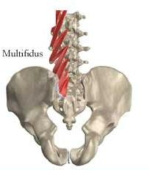
Healthy Multifidus, Healthy Back?
More than just an interesting correlation?
Low back pain is non-specific in ~70% of LBP patients
Lumbar multifidus muscle atrophy is present in ~80% of LBP patients
Potential benefits of a contracting multifidus:
Proprioceptive cues from multifidus contractions may be important
in maintaining low back health (“exercise is health”)
Many low back pain patients are unable (or unwilling) to perform low back exercises
Medial branch nerve provides:
sensory innervation of facet joints
motor innervation to multifidus, a core stabilizer of the spine
Multifidus
Should we
wait to ablate?
Notes:
RFA uses the tip of a needle to burn or "ablate" the nerve in an attempt to stop the pain signal.
The procedure is performed via a series of 4-6 needle sticks and is performed with the patient under conscious sedation)
A small needle is inserted very close to a nerve under image guidance to destroy the target nerve
In most patients the nerve grows back and the procedure may need to be repeated.
Is RFA being offered earlier than it should be?

Slide 16
More info…Multifidus and Low Back Pain
The prolonged absence of multifidus activity and contractility reduces proprioceptive central feedback
The absence of proprioceptive feedback may cause pain to be centralized even after the original pain generator heals
Centralization of pain may explain why LBP is so often non-specific
Increasing healthy peripheral inputs from contracting muscle may increase proprioceptive inputs and reverse central sensitization
Multifidus
Injury/Onset of Pain
Arthrogenic Inhibition
Reduced Multifidus Contraction
Atrophy and Fatty Infiltration
Reduced Central Proprioceptive Feedback
Central Hypersensitivity and Centralization of Pain
Pain Becomes Non-specific
Notes:
The absence of healthy afferent/proprioceptive feedback may potentiate back pain and increase the likelihood that pain becomes centralized
The restoration of healthy afferent/proprioceptive feedback may relieve back pain by addressing the problem from a central persepctive

Slide 17
Interventional Sub-indication Targets in LBP
 | Lumber Spinal Stenosis (LLS) | Sacroiliac Joint Pain | Vertebrogenic Pain | Axial Pain
Symptoms | Pain in back/legs/buttocks when standing; relief when sitting | Pain over SI joint, often with leg pain: commonly aggravated by walking and stairs | Localized back pain, no leg pain; MRI indicates Type I/II Modic changes | Localized back pain, no leg pain
Causes | Ligamentum flavum hypertrophy, disc bulging or foraminal narrowing impinging on spinal cord nerves | Damage or injury to SI joints | Vertebral endplate damage | Evidence of clear pain generator may be unclear; central sensitization is common
Notes:
LBP symptoms can derive from many potential anatomic sources: nerve roots, muscle, fascial structures, bones, joints, intervertebral discs, and abdominal organs
Identification of the specific source of pain can be challenging—most cases are classified as “non-specific” or mechanical (localized axial pain)
Leg pain often indicates LSS and is associated with SI joint problems

Slide 18
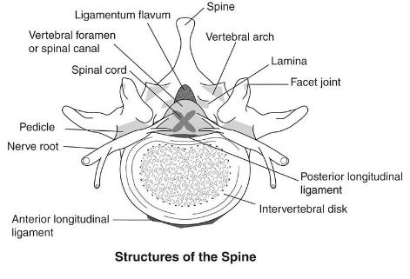
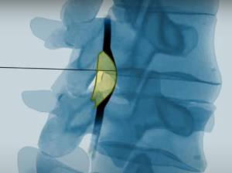
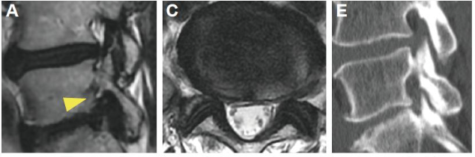
Lumbosacral Spinal Stenosis (LSS) Interventions
Approaches:
Debulk hypertrophic ligamentum flavum encroaching on spinal cord nerves (PILD procedure)
Insert spinal spacers to reduce stenosis associated with intervertebral foraminal encroachment upon extension
Ligamentum flavum
Hypertrophic Ligamentum
Flavum Encroachment
Koga, Mini-invasive Surg 2017;1:3-5

Slide 19
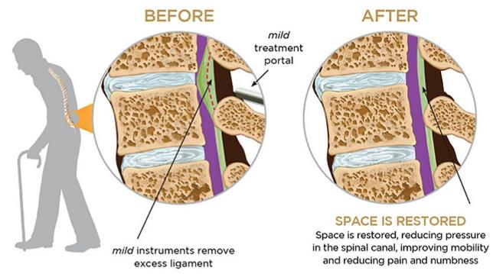

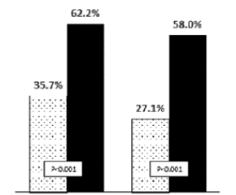
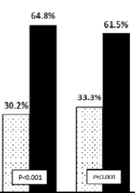
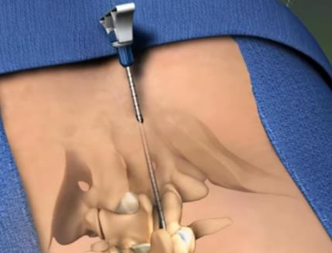
LSS Intervention: Debulking of Ligamentum Flavin
Improvements in Oswestry Disability Index (ODI) and Patient Satisfaction with Epidural Steroid Injections (ESI) Versus Percutaneous Image-guided Lumbar Decompression (PILD)
Disability
Patient Satisfaction
ESI
PILD
6 months
12 months
6 months
12 months
No difference in safety between PILD and ESIs
Champagne Pain Physician 2016
mild® procedure. Adopted from: https://www.youtube.com/watch?v=fE8BJMJmjM0
Notes:
Decompresses the spinal canal by removing small portions of lamina (for access) and hypertrophic ligamentum flavum while leaving the structural stability of the spine intact
Local anesthesia, 5mm incision
Fluoroscopic visualization (above) of the epidural working space identifies hypertrophic ligamentum flavum
Access tools are advanced from posterior, followed by a bone sculptor for access and a tissue sculptor to debulk the ligamentum flavum

Slide 20
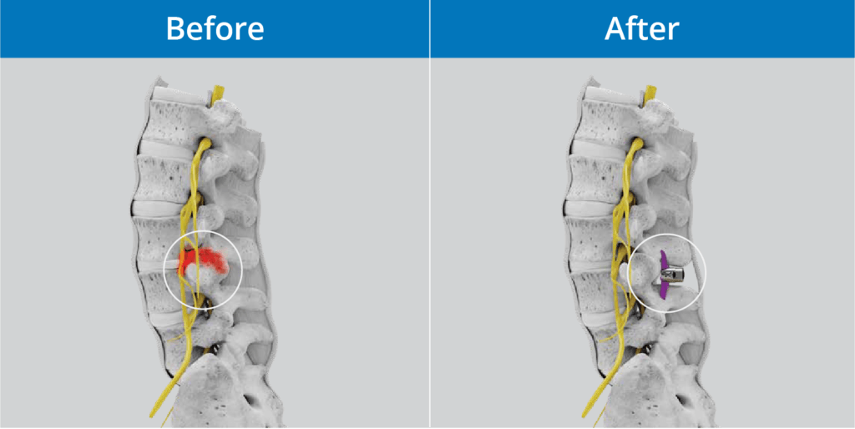
LSS Intervention – Interspinous Spacer Implant
spacer
Notes:
Interspinous process spacers are a less-invasive alternative to surgical decompression in patients who have failed nonsurgical management
The new procedure requires less surgical exposure that the prior spinal spacer technique. This is reflected is less blood loss and shorter hospital stay (Patel 2015)
A titanium device is inserted through a cannula about the size of a dime placed between adjacent spinous processes and, therefore, requires no surgical dissection of the spinal musculature

Slide 21
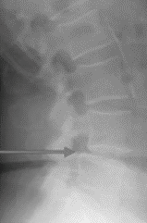
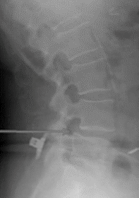
LSS Interventions– Interspinous Spacer Implant
Note increased disc height in extension following spacer implantation
Note lateral stenosis and reduced disc height on extension
spacer
1. Patel Spine 2015
Notes:
Interspinous process spacers are a less-invasive alternative to surgical decompression in patients who have failed nonsurgical management
The new procedure requires less surgical exposure that the prior spinal spacer technique. This is reflected is less blood loss and shorter hospital stay (Patel 2015)
A titanium device is inserted through a cannula about the size of a dime placed between adjacent spinous processes and, therefore, requires no surgical dissection of the spinal musculature

Slide 22
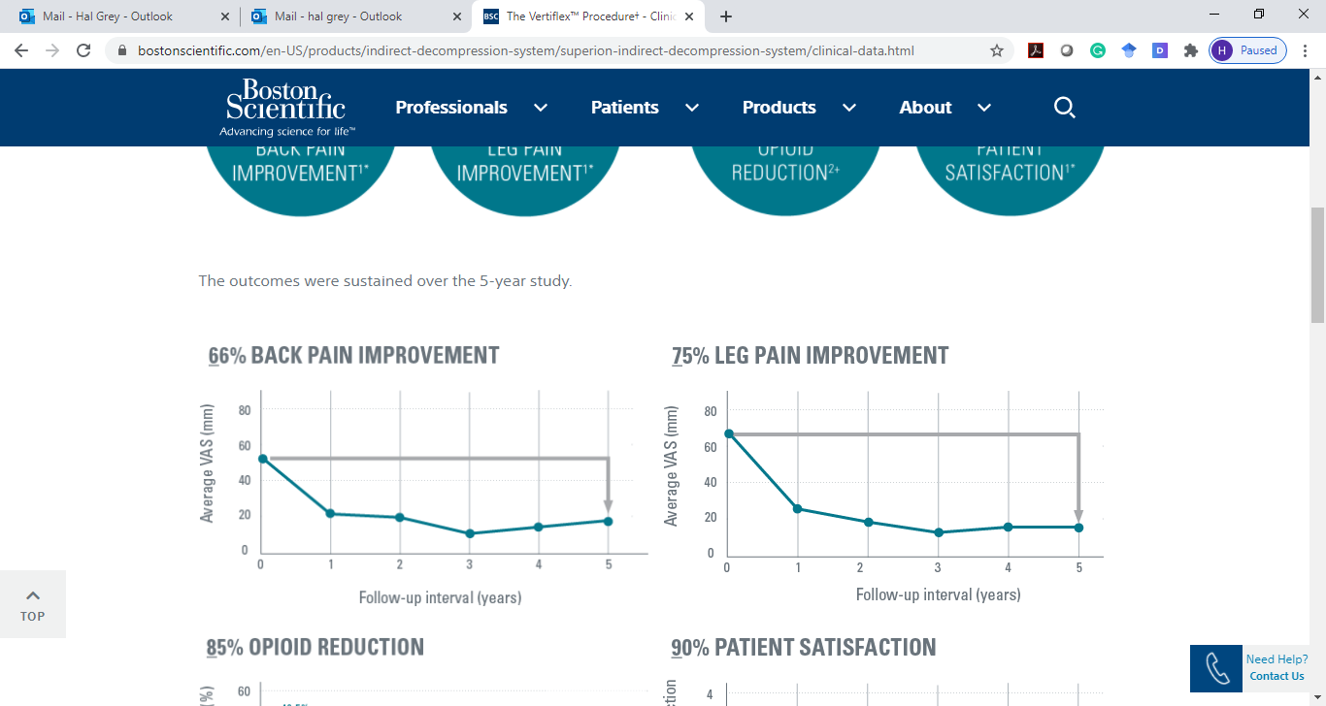
LSS Interventions– Interspinous Spacer Implant
66% back pain improvement¹
75% leg pain improvement¹
Nunley Clin Interv Aging 2017
Notes:
Interspinous process spacers are a less-invasive alternative to surgical decompression in patients who have failed nonsurgical management
The new procedure requires less surgical exposure that the prior spinal spacer technique. This is reflected is less blood loss and shorter hospital stay (Patel 2015)
A titanium device is inserted through a cannula about the size of a dime placed between adjacent spinous processes and, therefore, requires no surgical dissection of the spinal musculature

Slide 23
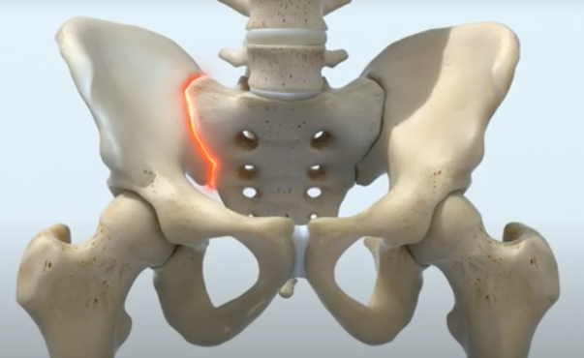
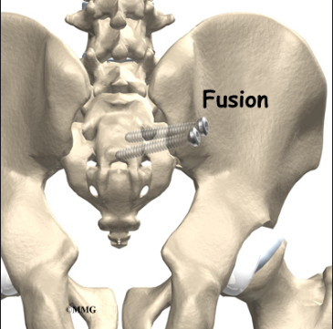
SI Joint Pain
Feeling of weakness or instability is common
Pain on provocative SI joint testing
Goal of treatment is to stabilize the SI joint
Several interventional options available, with or without graft material
Guidelines do not yet recommend one technique or device over another
Sacroiliac (SI) Joint
Conventional Surgical Fusion
Notes:
SI joint disease is typically caused by either inflammation of the sacroiliac joint (degenerative sacroiliitis), which may or may not be caused by sacroiliac joint dysfunction, and sacroiliac joint disruption, i.e. abnormal motion in the sacroiliac joint
Sacroiliac fusion involves the use of implanted screws or rods, as well as a possible bone graft across the joint. Minimally-invasive procedures have been developed in recent years that improve outcomes in pain and disability, and reduce recovery time
Open treatment of SI joint dysfunction dates to 1908
Recently, minimally invasive techniques have gained wide popularity. They can be divided into lateral or posterior approaches.
Several devices have been approved in the United States for MIS SI joint fusion, including the iFuse Implant System (SI-BONE, Inc.), the most studied device, and the Rialto SI Fusion System (Medtronic).
No clear guidelines exist to support the use of one technique or device

Slide 24
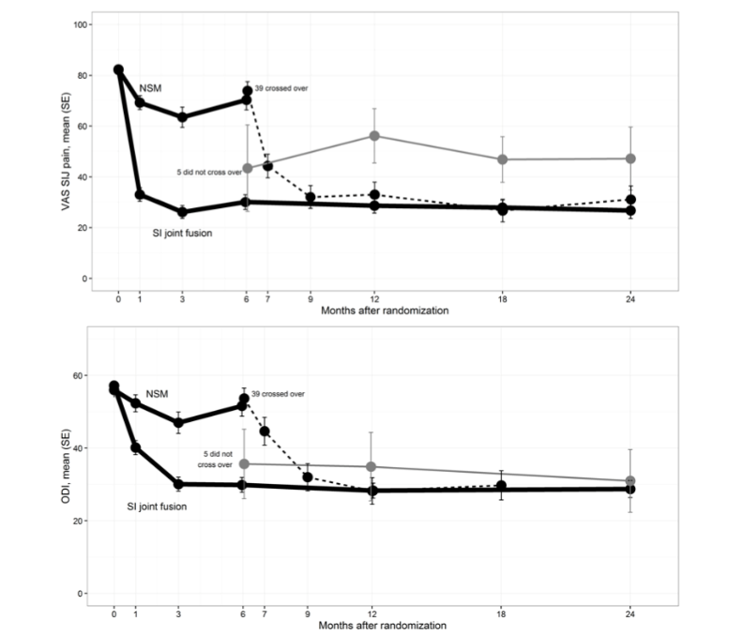
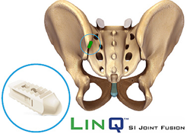
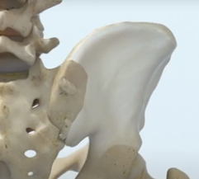
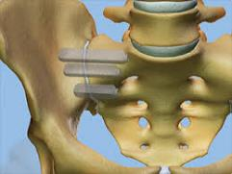
SI Joint Interventions: Fusion/Stabilization
Multiple treatment options exist,
some without long term data
Pain: Non-surgical Management (NSM) vs Minimally invasive fusion
Disability: Non-surgical Management (NSM) vs Minimally invasive fusion
1. Polly Int J Spine Surg 2016
Notes:
The data is related to a single manufacturer’s product and approach. Outcomes from other newer approaches cannot be made at this time.

Slide 25
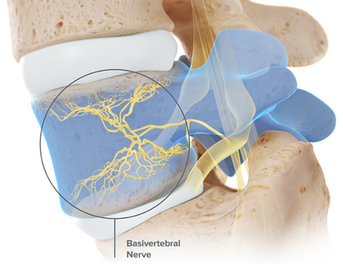
Vertebrogenic LBP
Intraosseous nerves within the vertebral body were first described in 1998
The vertebral endplates can be a source of pain
Pain is generally accompanied by Type 1 or Type 2 Modic changes on MRI
Modic type I changes are related to bone marrow edema and inflammation signifying acute degenerative changes in the vertebral end plate.
Modic type II changes signify fatty degeneration of the bone marrow.
Adopted from:
https://www.relievant.com/intracept-procedure/
Notes:
Conventional radiofrequency ablation ablates either the medial branch nerve adjacent to the facet joint (nonspecific axial pain)
A newer approach ablates the basivertebral nerve for pain that originals from vertebral endplate damage confirmed through imaging (vertebrogenic pain)
This approach is based on research that shows vertebral endplates are a significant source of chronic back pain.
The basivertebral nerve innervates both the superior and inferior endplates transmits

Slide 26
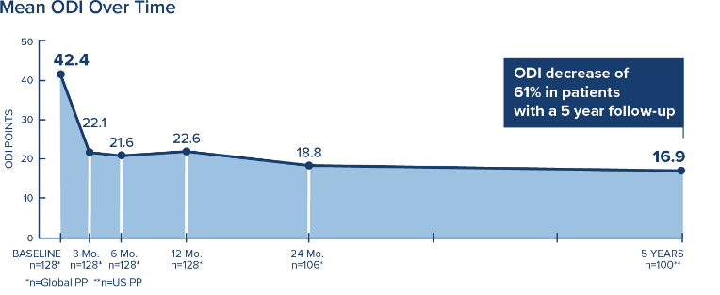
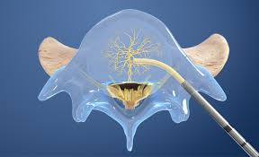
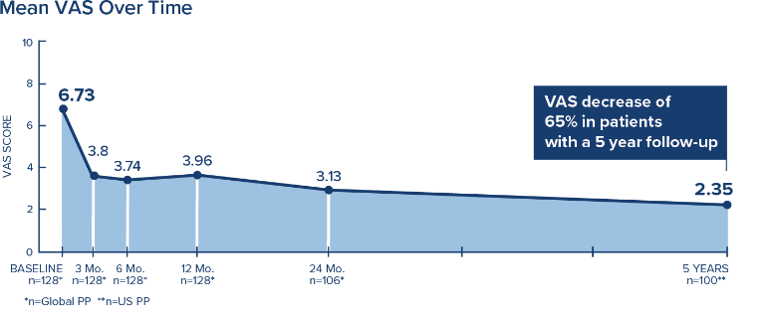
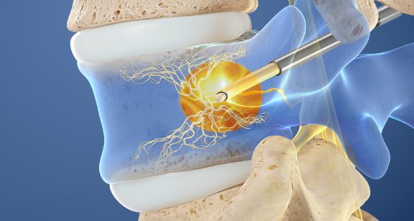
Axial LBP Treatments: Basivertebral Nerve Ablation
1. Fischgrund Int J Spine Surg 2020

Slide 27
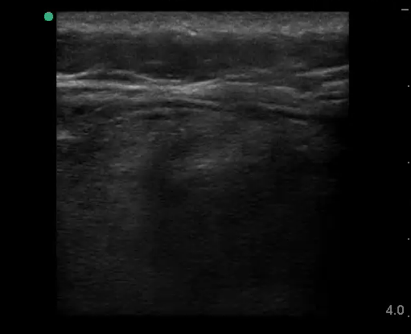
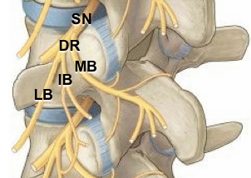
Axial LBP Intervention: 60-day Medial Branch PNS
  Peripheral nerve stimulation (PNS) of the medial branch nerve
Medial Branch Stimulation
Medial Branch PNS induces cycling tension within the multifidus muscle
Multifidus contractions induce activation of afferent (sensory and proprioceptive) signals terminating in the cortex
Notes:
Stimulation – sometimes called the “digital drug” – use electrodes to deliver electricity directly to a targeted nerve to elicit a motor and sensory response
Peripheral nerve stimulation, which may involve either a temporary or permanent implant,
stimulates the medial branch nerve

Slide 28
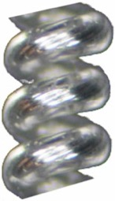
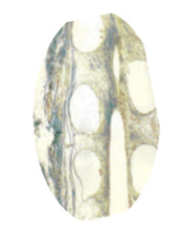
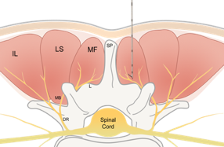


Axial LBP Intervention: 60-day Medial Branch PNS
  Peripheral nerve stimulation (PNS) of medial branch nerve, for up to 60 days
100 µm
Fibrotic ingrowth around the coiled lead is intended to minimize infection risk during the 60-day treatment period
Notes:
Lead placement is very similar to other similar approaches such as injection and RFA
Lead is constructed using a 100 micron wire
Infections are minimized over the 60-day indwelling period as fibrotic tissue invades the open coil to prevent ingress of contaminants

Slide 29
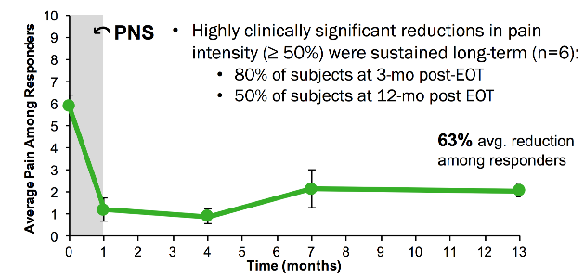
Axial LBP Intervention: 60-day Medial Branch PNS
Opioid Use²
Pain²
Pain relief often endures well beyond treatment period¹
73% ≥50% reduction in opioids
Average 23 MME reduction among responders
64% ≥50% pain relief
Average 70% reduction among responders
ODI²
Pain Interference²
82% ≥ 10-pt reduction
Average 26-pt reduction among responders
82% ≥ 30% reduction
Average 69% reduction among responders
Gilmore Pain Pract 2020
Gilmore ASPN 2019

Slide 30
Considering PNS Versus RFA
When is multifidus preservation important?
  In the younger patient to minimize multifidus atrophy?
  In the older already atrophic patient?
  A and B
It’s in both populations, of course!
Ekin et al, Diagn Interven Radiol 2016; 22: 273-276

Slide 31
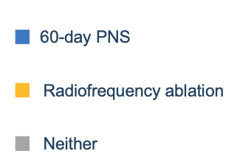
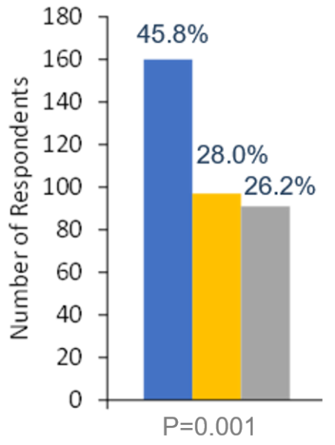
Patient Preference Survey (n=347)
Survey of patients (aged 34–75) with activity-limiting moderate-to-severe axial back >6 months duration
Potential complications include:
  For RFA:
    Multifidus denervation
  For 60-day PNS:
    Potential for 100-micron lead fracture
Patients overwhelmingly preferred PNS as a motor-sparing option
*Gulati, et al. Rethink your Pain Strategy. Presented at: American Academy of Pain and Neuroscience webinar, August 2020.
Notes:
When presented with the option for RFA or 60-day medial branch PNS and with a clear view for potential risks and benefits, patients overwhelmingly prefer PNS as a motor sparing option

Slide 32
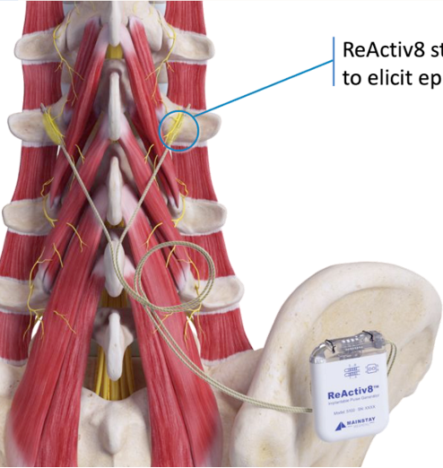

Axial LBP Intervention: Permanent PNS Implant
Permanently Implanted Medial Branch Stimulation Leads
Medial branch stimulation delivered for two 30-minute sessions daily in which the patient is lying prone
Permanently Implanted
Pulse
Generator
Notes:
It should be noted that 40% of implanted subjects did not obtain significant relief. Best practice is to conduct a trial prior to implanting a permanent device.
AEs (n 204) were for infection (3%), implant site pain (14%), lead fracture (1.4%)
Surgical interventions ( n 204) were for system explants (7%) and lead replacement (3%)

Slide 33
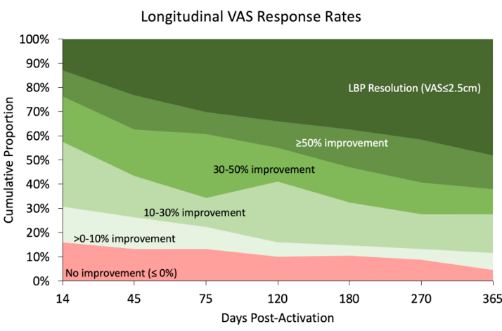
Axial LBP Intervention: Permanent PNS Implant
62% of patients with >50% improvement or with mild pain <2.5/10
A percutaneous trial may have prevented permanent implantation ( and subsequent explant) in a non-responder
38% of patients with no or minimal improvement
Temporary stimulation was not performed in these subjects prior to implanting the permanent system
As presented July 16, 2020 at INS NACC Webinar: The Right Device for the Right Patient - Case Presentations and Discussions
Notes:
It should be noted that 40% of implanted subjects did not obtain significant relief. Best practice is to conduct a trial prior to implanting a permanent device.
AEs (n 204) were for infection (3%), implant site pain (14%), lead fracture (1.4%)
Surgical interventions ( n 204) were for system explants (7%) and lead replacement (3%)

Slide 34
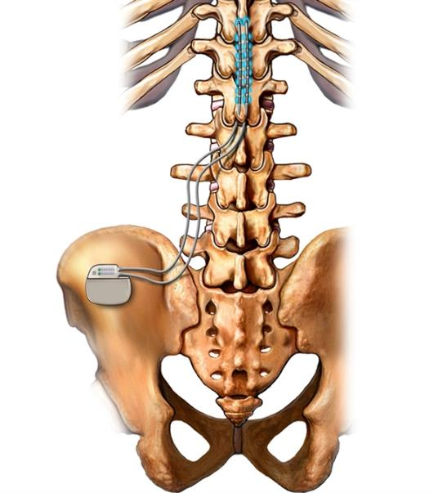
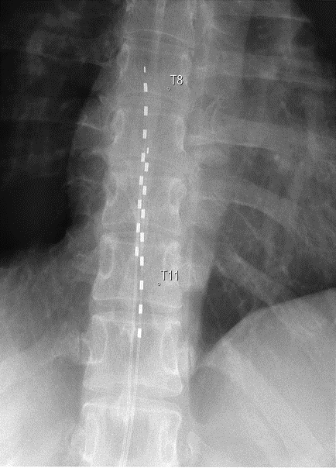
Axial LBP Intervention: Permanent SCS Implant
1. Al-Kaisy Pain Med 2018

Slide 35
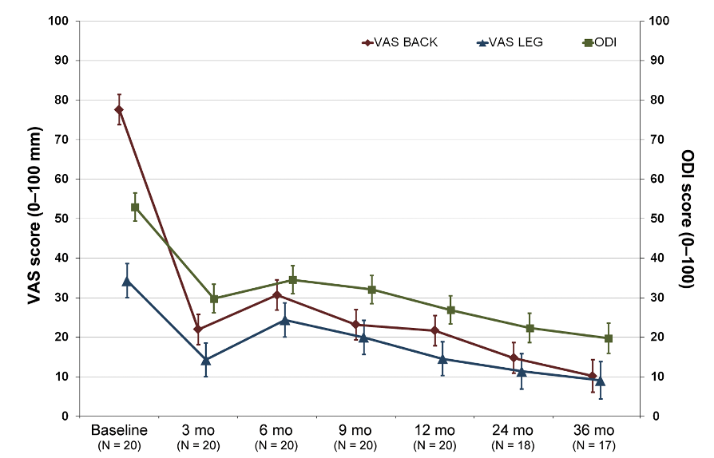
Axial LBP Intervention: Permanent SCS Implant
1. Al-Kaisy Pain Med 2018
Notes:
This study was completed using a 10KHz SCS System in virgin back patients
Most patients would prefer non-spinal and non-permanent implants

Slide 36
Patient Preference Survey Outcomes
Patient Preference Survey (n=453)
Permanent SCS/DRG
Implant
Non-permanent treatments are highly preferred
Permanent spinal implants are least favored
RFA
Permanent PNS
Implant
60-day PNS
Data on file, SPR Therapeutics
Notes:
Add reference

Slide 37
Chronic “Virgin” (non=operated) LBP
(>3 mo)
Failed conservative/injection treatment
Patient
preference
Potential end treatments
Rule out specific pathologies
(e.g., fracture, cancer, infection)
Leg pain worsens when standing or walking, relieved when sitting or bending (Lumbar Spinal Stenosis)
Pain over SI joint,
mechanically provoked; may or may not present with leg pain
Back pain without leg pain
Editable format
PILD procedure
P
Spacer implants
Fusion
Implants
P
Stimulation
temporary implant
Stimulation permanent implant
Ablation

Slide 38
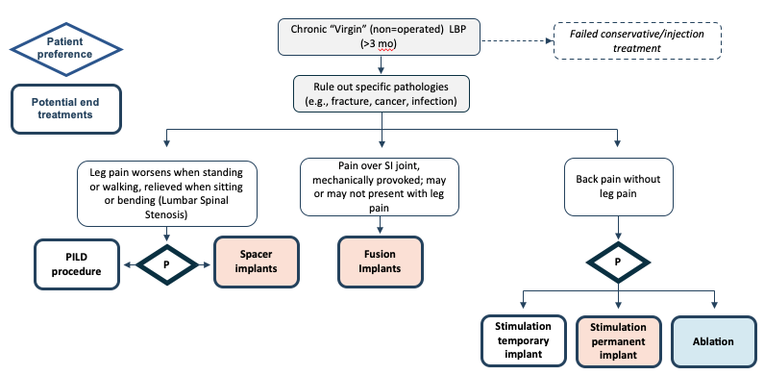
LBP Interventional Treatment Algorithm
Notes:
There are a plethora of minimally invasive interventions practiced by interventional pain management physicians
Unless there is a neurological emergency, many more invasive surgeries may be avoided or delayed

Slide 39
Back pain without leg pain
Patient
preference
P
Stimulation
Ablation
Medial branch block
Potential end treatments
Negative
Positive
Peripheral Nerve Stimulator Treatment (60-days)
Spinal Cord Stimulation Trial (3-10 days)
P
Modic changes on X-ray
Editable format
Success
No
Re-evaluate
No
Success
Yes
Sustained
Yes
Periodic follow up
No
Implant Permanent Spinal Cord Stimulator
Implant permanent
PNS system
Basivertebral
denervation
Medial branch denervation

Slide 40
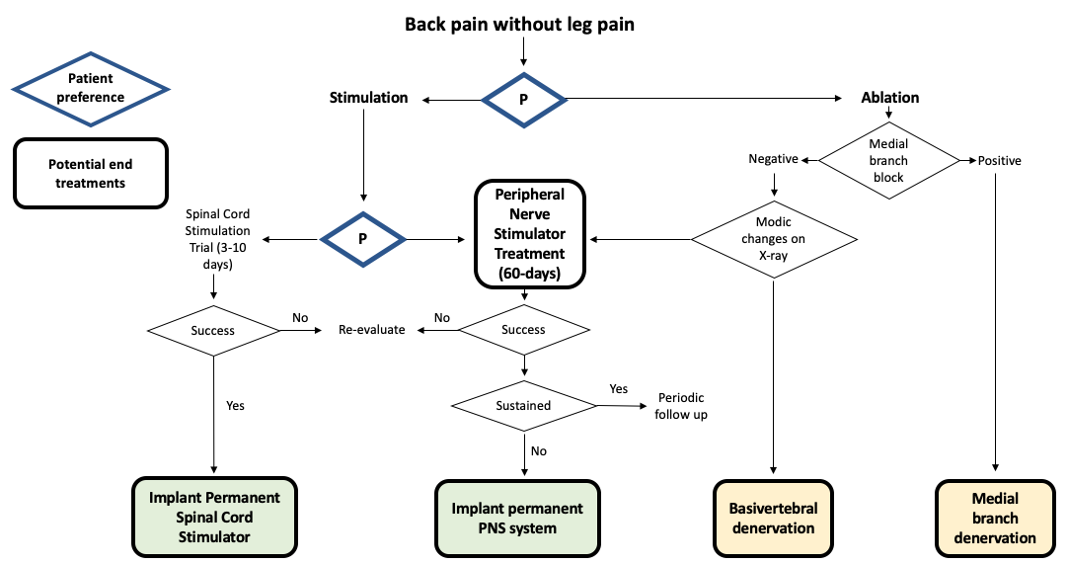
Axial LBP Interventional Treatment Algorithm
Notes:
The physician should discuss patient preference and options with patients to help direct the patient to the ideal practitioner and to avert fears regarding overly invasive or destructive procedures.
Two key questions:
Would you prefer a short term implant that stimulates nerves or a treatment that ablates nerves?
Would you prefer a stimulatory procedure that targets the spinal cord or one that avoids the spinal cord (i.e., the peripheral nerves)?

Slide 41
LBP Interventional Treatment Safety Summary
 | Debulking Intervention¹ | Interspinous Spacer² | 60-day PNS³ | Permanent PNS⁴ | Spinal Cord Stimulation⁵
Serious Adverse Event* Rate (%) | 0.0% | 8.4% | 0.0% | 11.0%† | 9.0%†
*Procedure - or device-related
†Rate of surgical interventions required
Champagne Pain Physician 2016
Patel Spine 2015
Gilmore RAPM 2019
As presented July 16, 2020 at INS NACC Webinar: The Right Device for the Right Patient - Case Presentations and Discussions
https://www.accessdata.fda.gov/cdrh_docs/pdf13/P130022b.pdf
Notes:
Speakers should clarify that “serious adverse events” may not be the appropriate term…when SAE’s were not evident, surgical re-operation rate was used.
SAE rates are taken from published literature or public presentations

Slide 42
Summary
LBP is the leading cause of global disability
The opioid crisis has driven development and adoption of new FDA-cleared interventional treatment options for LBP
Patients generally prefer treatments that do not involve permanent implants or motor impairment
Check with your pain physician to better understand what interventions they are offering and trained to perform

Slide 43
References
Vos T, Allen C, Arora M, et al. Global, regional, and national incidence, prevalence, and years lived with disability for 310 diseases and injuries, 1990–2015: a systematic analysis for the Global Burden of Disease Study 2015. Lancet. 2016;388(10053):1545-1602.
Hartvigsen J, Hancock MJ, Kongsted A, et al. What low back pain is and why we need to pay attention. Lancet. 2018;391(10137):2356-2367.
Rubin DI. Epidemiology and risk factors for spine pain. Neurol Clin. 2007;25(2):353-371.
Meucci RD, Fassa AG, Faria NMX. Prevalence of chronic low back pain: systematic review. Rev Saude Publica. 2015;49:73.
Cohen SP. Sacroiliac joint pain. In: Essentials of Pain Medicine. Elsevier; 2018:601-612. e602.
Ishimoto Y, Yoshimura N, Muraki S, et al. Prevalence of symptomatic lumbar spinal stenosis and its association with physical performance in a population-based cohort in Japan: the Wakayama Spine Study. Osteoarthritis Cartilage. 2012;20(10):1103-1108.
Woolf CJ. Central sensitization: implications for the diagnosis and treatment of pain. Pain. 2011;152(3 Suppl):S2-15.
Kuner R, Flor H. Structural plasticity and reorganisation in chronic pain. Nat Rev Neurosci. 2017;18(1):20.
Allegri M, Montella S, Salici F, et al. Mechanisms of low back pain: a guide for diagnosis and therapy. F1000Research. 2016;5.
Raad M, Pakpoor J, Harris AB, et al. Opioid Prescriptions for New Low Back Pain: Trends and Variability by State. J Am Board Fam Med. 2020;33(1):138-142.
Deyo RA, Von Korff M, Duhrkoop D. Opioids for low back pain. BMJ. 2015;350.
Gilmore C, Kapural L, Hopkins T, et al. Reductions in Opioid Consumption with Percutaneous Nerve Stimulation (PNS) for Chronic Low Back Pain. Poster presented at: 18th Annual Meeting of the American Society of Regional Anesthesia and Pain Medicine, 2019 Nov 14-16, New Orleans, LA.
Al-Kaisy A, Palmisani S, Smith TE, et al. Long-term improvements in chronic axial low back pain patients without previous spinal surgery: a cohort analysis of 10-kHz high-frequency spinal cord stimulation over 36 months. Pain Med. 2018;19(6):1219-1226.
Chou R, Hashimoto R, Friedly J, et al. Pain management injection therapies for low back pain [Internet]. Rockville (MD): Agency for Healthcare Research and Quality (US); 2016 Feb. (Comparative Effectiveness Reviews, No. 169.)
Chappell ME, Lakshman R, Trotter P, Abrahams M, Lee M. Radiofrequency denervation for chronic back pain: a systematic review and meta-analysis. BMJ open. 2020;10(7):e035540.
Cedeno DL, Vallejo A, Kelley CA, Tilley DM, Kumar N. Comparisons of lesion volumes and shapes produced by a radiofrequency system with a cooled, a protruding, or a monopolar probe. Pain Physician. 2017;20(6):E915-E922.

Slide 44
References
Cohen SP, Bhaskar A, Bhatia A, et al. Consensus practice guidelines on interventions for lumbar facet joint pain from a Multispecialty, International Working group. Reg Anesth Pain Med. 2020;45(6):424-467.
Koga H. Improved percutaneous endoscopic translaminar approach for lumbar foraminal stenosis at L5/S1. Mini-invasive Surg. 2017;1:3-5.
Champagne I, Centers P, Shrewsbury N, Hopkins J, Benyamin R. MILD® is an effective treatment for lumbar spinal stenosis with neurogenic claudication: MiDAS ENCORE randomized controlled trial. Pain Physician. 2016;19:229-242.
Patel VV, Whang PG, Haley TR, et al. Superion interspinous process spacer for intermittent neurogenic claudication secondary to moderate lumbar spinal stenosis: two-year results from a randomized controlled FDA-IDE pivotal trial. Spine (Phila Pa 1976). 2015;40(5):275-282.
Polly DW, Swofford J, Whang PG, et al. Two-year outcomes from a randomized controlled trial of minimally invasive sacroiliac joint fusion vs. non-surgical management for sacroiliac joint dysfunction. International journal of spine surgery. 2016;10.
Fischgrund JS, Rhyne A, Franke J, et al. Intraosseous basivertebral nerve ablation for the treatment of chronic low back pain: 2-year results from a prospective randomized double-blind sham-controlled multicenter study. Int J Spine Surg. 2019;13(2):110-119.
Gilmore CA, Kapural L, McGee MJ, Boggs JW. Percutaneous Peripheral Nerve Stimulation for Chronic Low Back Pain: Prospective Case Series With 1 Year of Sustained Relief Following Short‐Term Implant. Pain Pract. 2020;20(3):310-320.
Ekin EE, Yıldız HK, Mutlu H. Age and sex-based distribution of lumbar multifidus muscle atrophy and coexistence of disc hernia: an MRI study of 2028 patients. Diagn Interv Radiol. 2016;22(3):273.
Gulati, et al. Rethink your Pain Strategy. Presented at: American Academy of Pain and Neuroscience webinar, August 2020.
Gilmore CA, Ilfeld BM, Rosenow JM, Li S, Desai MJ, Hunter CW, Rauck RL, Nader A, Mak J, Cohen SP, Crosby ND, Boggs JW. Percutaneous 60-day Peripheral Nerve Stimulation Implant Provides Sustained Relief of Chronic Pain Following Amputation: 12-month Follow-Up of a Randomized, Double-Blind, Placebo-Controlled Trial. Regional Anesthesia and Pain Medicine, 2019.
https://www.accessdata.fda.gov/cdrh_docs/pdf13/P130022b.pdf

Slide 45
Thank you!
"Lumbar Spine X-Ray L4 L5 S1" by planetc1 is licensed under CC BY-SA 2.0

